Slide 1
AUTOMATION FRAMEWORK…
Automation tool : selenium
Programming language : python
by Group 6 : septonics

Slide 2
We created automation code for following scenario
Navigate to “https://Demo.guru99/v4/site”.
Verify login works with correct credentials.
Click on new customer , fill all the details and verify submitting the data.
Verify “Customer Registered Successfully!!!” page and ensure all details are same as entered.
Pick customer id and click “Edit Customer” , verify editing details of above created customer.
Verify deleting above customer.

Slide 3
CODE
from selenium import webdriver from selenium.webdriver.common.by import By import time class Chrome(): def __init__(self): driverlocation = r'C:\Users\computer world\.wdm\drivers\chromedriver\win32\104.0.5112\chromedriver.exe' # loading chrome browser self.driver = webdriver.Chrome(driverlocation) def loginTC(self): try: self.driver.implicitly_wait(3) url = "http://www.demo.guru99.com/V4/" self.driver.get(url) userForm = self.driver.find_element(By.XPATH, "//input[@name='uid']") userForm.send_keys("mngr435500") pwForm = self.driver.find_element(By.XPATH, "//input[@name='password']") pwForm.send_keys("hurUvUh") loginButton = self.driver.find_element(By.XPATH, "//input[@value='LOGIN']") loginButton.click() time.sleep(2)

Slide 4
addCustomer = self.driver.find_element("link text", 'New Customer') addCustomer.click() time.sleep(1) customerName = self.driver.find_element("name",'name') customerName.send_keys('SEPTONICS') time.sleep(1) customerDob = self.driver.find_element("name",'dob') customerDob.send_keys('25-08-2022') time.sleep(1) customerAddr = self.driver.find_element("name",'addr') customerAddr.send_keys('Chandigarh') time.sleep(1) customerCity = self.driver.find_element("name",'city') customerCity.send_keys('Chandigarh') time.sleep(1) customerState = self.driver.find_element("name",'state') customerState.send_keys('Punjab') time.sleep(1) customerPin = self.driver.find_element("name",'pinno') customerPin.send_keys('133301') time.sleep(1) customerPhone = self.driver.find_element("name",'telephoneno') customerPhone.send_keys('9536453258') time.sleep(1) customerEmail = self.driver.find_element("name",'emailid') customerEmail.send_keys('rs09798087@gmail.com') time.sleep(1) customerPass = self.driver.find_element("name",'password') customerPass.send_keys('2345')

Slide 5
time.sleep(1) customerSub = self.driver.find_element("name",'sub') customerSub.click() time.sleep(1) customerDelete = self.driver.find_element("link text", 'Delete Customer') customerDelete.click() time.sleep(1) customerID = self.driver.find_element("name",'cusid') customerID.send_keys('59610') time.sleep(1) customerSub = self.driver.find_element("name",'AccSubmit') customerSub.click() print("Logged in") # self.driver.quit() except Exception as errorMessage: print("This is the error: " + str(errorMessage)) chromeBrowser = Chrome() chromeBrowser.loginTC()

Slide 6
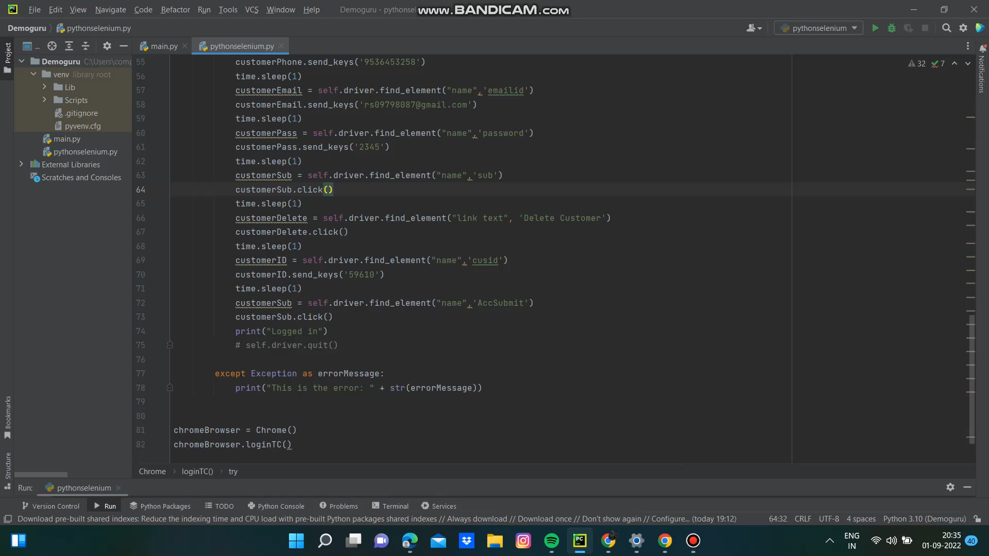
output

Slide 7
PRESENTED BY SEPTONICS GROUP (6) FROM SVIET COLLEGE…
MEMBERS:
SOMYA SINHA ( LEADER)
RUPALI SHARMA
VIKAS PAL
MADHURENDRA KUMAR
HRITIKESH KUMAR
AMIT KUMAR YADAV
PRABHANJAN PANDEY

Slide 8


